Slide 1
4.3 Fundamentals of algorithms
Time Complexity
Big-O Notation

Slide 2
Specification Objectives
Be familiar with the concept of a function as a mapping from one set of values to another
Be familiar with the concept of constant, linear, polynomial, exponential and logarithmic functions
Be familiar with the notion of permutation of a set of objects or values
Be familiar with the Big-O notation to express time complexity
Be able to derive the time complexity of an algorithm

Slide 3
How efficient is an algorithm?
We can sum the numbers from 1 to 1000 using the following algorithm:
sum = 0
FOR count = 1 TO 1000
sum = sum + count
ENDFOR
Or, we can use a single statement to calculate the sum:
sum = 1000 * (1000 + 1)/2
Which is more efficient? Why?

Slide 4
A measure of efficiency
The number of assignment statements to be executed in the first algorithm is 1001
sum = 0
FOR count = 1 TO 1000
sum = sum + count
ENDFOR
In the second algorithm, only two statements are executed:
n = 1000
sum = n * (n + 1)/2
The number of assignment statements is a good basic measure of efficiency

Slide 5
Execution time vs problem size
For most problems, the larger the size of the problem or amount of data, the longer the execution time
How many steps will it take to sum n items?
sum = 0
FOR count = 1 TO n
sum = sum + count
ENDFOR
How many statements in the second algorithm?
sum = sum + n * (n + 1)/2

Slide 6
Mathematics revision
Recall from mathematics
A function is defined by an equation such as y = 3x + 2
A generalised form would be f(n) = 3n + 2

Slide 7
Big-O notation
Big-O notation is a measure of the time complexity of an algorithm
It is a useful approximation to the actual number of steps in a computation
An algorithm of time complexity O(n) increases linearly
10,000 items will take approximately twice as long as 5,000 items to process
There is no such thing as, for example, O(2n + 1)
Only the dominant term counts, so it is O(n)

Slide 8
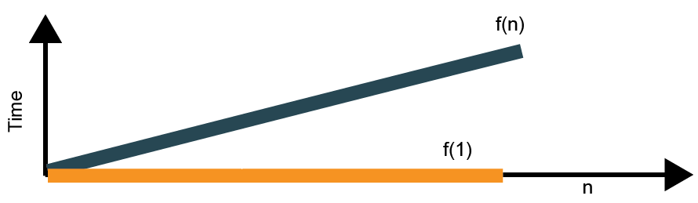
Linear functions
A linear function takes the form f(n) = an + b where a and b are constants
f(n) = 3n, f(n) = n + 5, f(n) = 6n + 1 are all examples of linear functions
f(1) is a constant function – no matter how large n gets, f(1) stays the same size. f(3), f(100) are all constant functions
f(n) is called the order of magnitude function for a linear function, and is written O(n)

Slide 9
Quadratic functions
A quadratic function takes the form
f(n) = an² +bn + c where a, b and c are constants
As n becomes large, the n² term increases very much faster than either of the other terms
f(n²) is called the order of magnitude function for a quadratic function, and is written O(n²)
The dominant term is the one used when comparing algorithms, so the bn term is not considered

Slide 10
Logarithmic functions
A logarithm is a shorthand method for writing numbers of the form base^{exponent}.
A logarithmic function takes the form f(n)=log₂(n)
Consider n=2^{f(n)}, as a logarithm f(n)=log₂(n)
8=2³ ➔ 3=log₂8 and 1024=2¹⁰ ➔ 10=log₂1024
f(n) increases very slowly in relation to n
The order of magnitude function for a logarithmic function is written O(log n)
We’re only concerned with base 2, f(n)=log₂(n)

Slide 11
Analysing an algorithm
What is the number of steps in the following computation?
total ← 0
FOR student ← 1 TO n
FOR mark ← 1 TO 3
total ← total + results[student][mark]
ENDFOR
ENDFOR
FOR students ← 1 TO n
average[student] ← (mark[1]+mark[2]+[mark[3])/3
ENDFOR

Slide 12
Deriving Big-O
There are 1 + 3n + n assignment statements
The algorithm has time complexity O(n)
total ← 0
FOR student ← 1 TO n
FOR mark ← 1 TO 3
total ← total + results[student][mark]
ENDFOR
ENDFOR
FOR students ← 1 TO n
average[student] ← (mark[1]+mark[2]+[mark[3])/3
ENDFOR

Slide 13
Logarithmic functions
“Divide and conquer” algorithms work by halving the size of the problem at each pass
A binary tree search algorithm is a good example of this
For a balanced tree of 1024 (i.e. 2¹⁰) items, only 10 items need to be examined
For a tree of 2048 (i.e. 2¹¹) items, only 11 items need to be examined
Time complexity increases very slowly as the problem size increases
It is logarithmic, that is, O(log n)

Slide 14
Time COmplexity Worksheet
Try the questions in Task 1 of the worksheet
n | n² | 5n² | 10n | 2 | f(n)= 5n²+ 10n + 2
10 |  |  |  | 2
100 |  |  |  | 2
1000 |  |  |  | 2
10,000 |  |  |  | 2

Slide 15

Permutations
A permutation of n items is the number of ways the n items can be arranged
There are two types of permutation:
Repetition allowed; for example, a combination lock with 4 digits 0 to 9
No repetition allowed; for example, you have 4 differently coloured balls in a bag, and you draw them out one at a time

Slide 16
Permutations with repetition
Suppose you have a combination lock with 2 digits
There are 10 possibilities for the first digit
For each of these numbers, the second number can be any digit between 0 and 9
00,01,02,03…..09
10,11,12,13…. 19 …. …. 90, 91, 92, 93…..99
There are 100 ways of choosing just 2 digits!
How many ways of choosing 3 digits? 4 digits?
This problem is O(10^{n}). Can you explain why?

Slide 17
Permutations with no repetition
Suppose you have a bag with 3 coloured balls, red, blue, green, and you pick out one at a time
There are 3 possibilities for the first ball, two possibilities for the second ball, one for the third
There are 3 x 2 x 1 ways of picking out the three balls
What if there were 5 differently coloured balls? 7 differently coloured balls?
Can you generalise the formula to show the time complexity of an algorithm that prints out all the ways of picking n different coloured balls in different orders?

Slide 18

Permutations with no repetition
There are 3! ways of picking or arranging 3 balls
The time complexity of an algorithm to print out the different ways is O(n!)

Slide 19
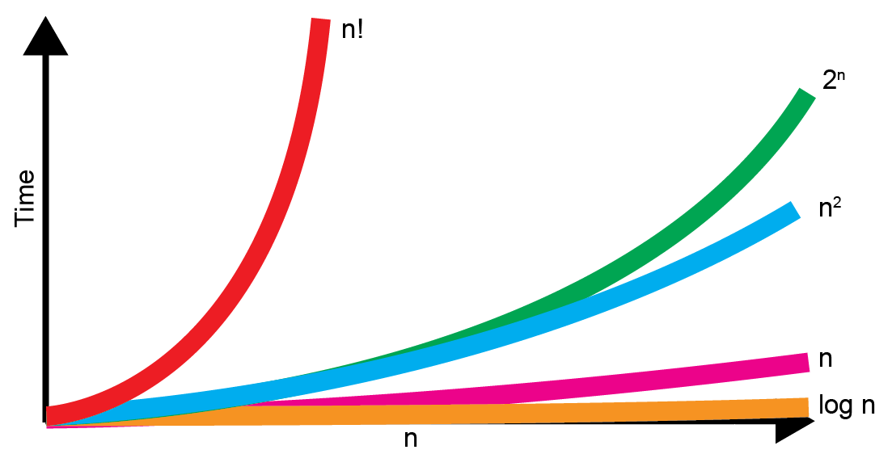
Comparison of time complexities

Slide 20
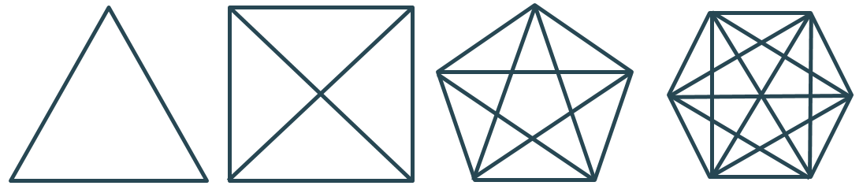
Time Complexity Worksheet
Try the questions in Task 2 of the worksheet

Slide 21
Summary
Big-O notation is used to compare the time complexity of different algorithms
Algorithms with time complexity O(n!) and O(2^{n}) are hopelessly inefficient for large values of n
Algorithms of O(log n) are extremely efficient for large values of n, with computation time increasing only slightly as the number of items doubles

Slide 22
Calculating Big-O Summary
To calculate the order of an algorithm in Big-O notation, count the number of assignment statements in the algorithm
Three assignment statements in two nested FOR loops each of length n, for example, is 3n² statements
Only the dominant term is significant, and any constant coefficient is ignored, so if there are, say, 3n² + 5n + 2 statements, the time complexity is O(n²)

